Slide 1

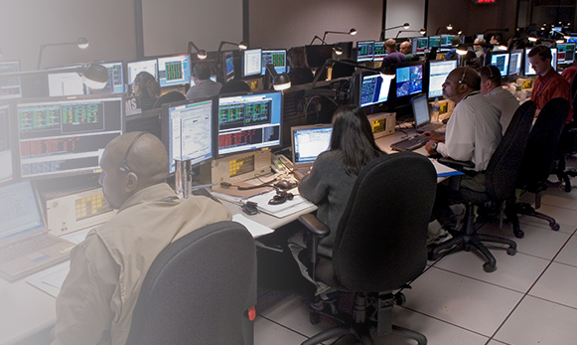

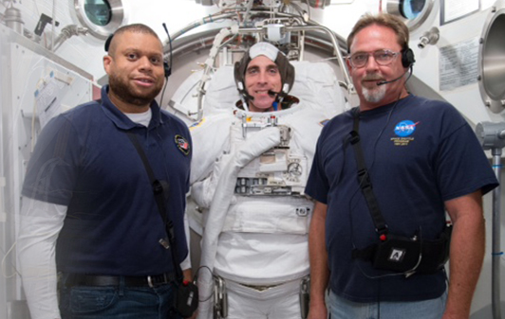
Lunch Sponsored by:

Slide 2
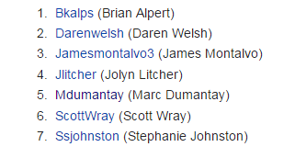
List of People

Slide 3
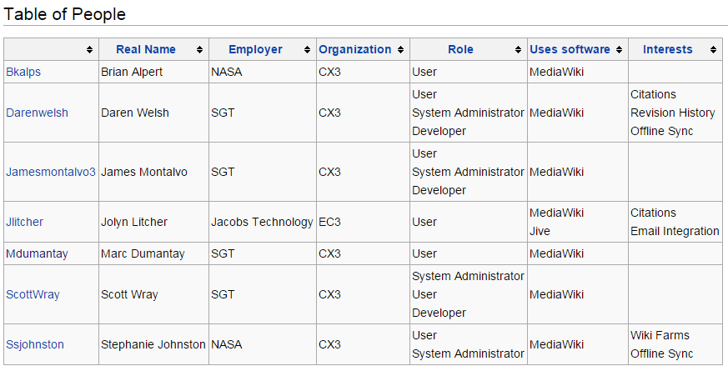
Table of People

Slide 4
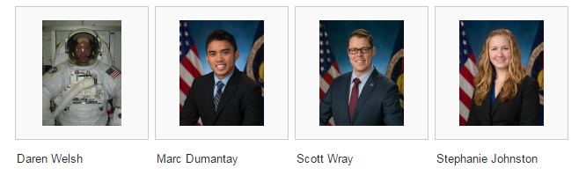
Gallery of People

Slide 5

Locations of People

Slide 6

Distance Traveled

Slide 7
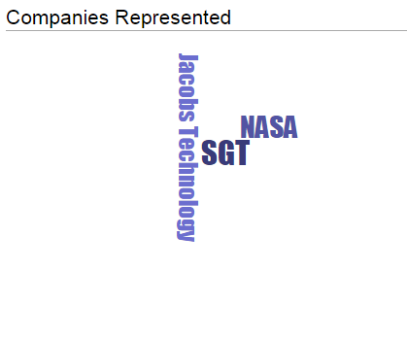
Companies Represented

Slide 8
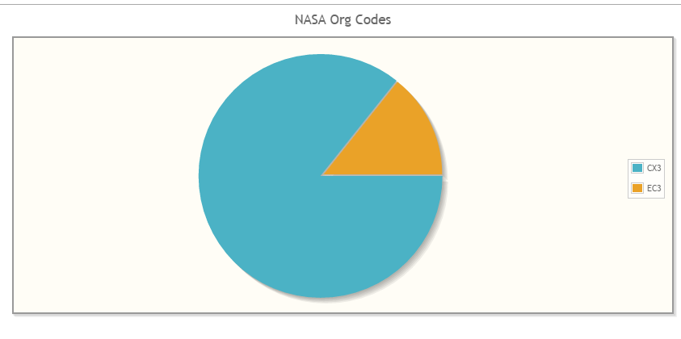
NASA Organizations

Slide 9

Years Experience in Knowledge Management

Slide 10
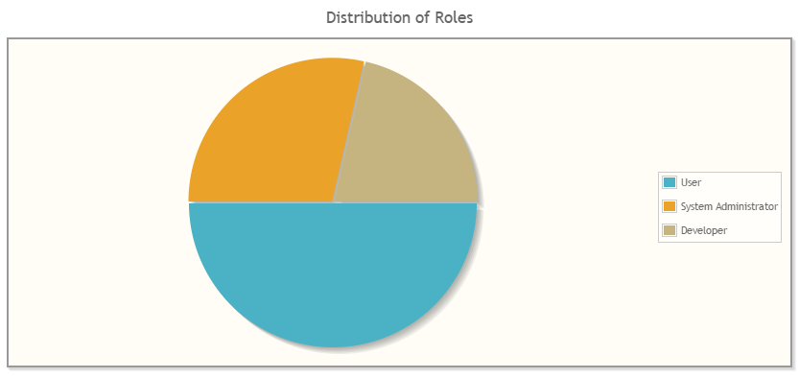
Distribution of Roles

Slide 11
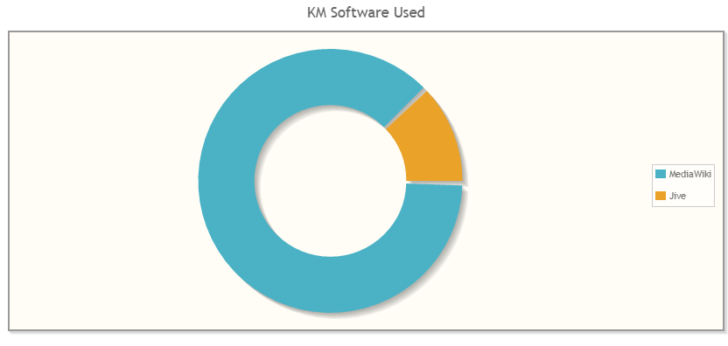
Knowledge Management Software Used

Slide 12

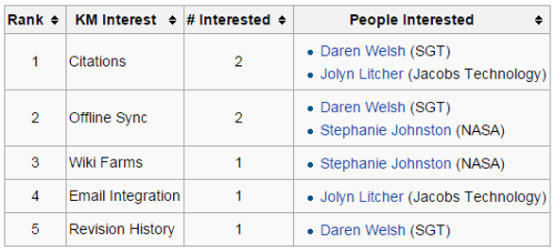
Knowledge Management Interests

